Slide 1
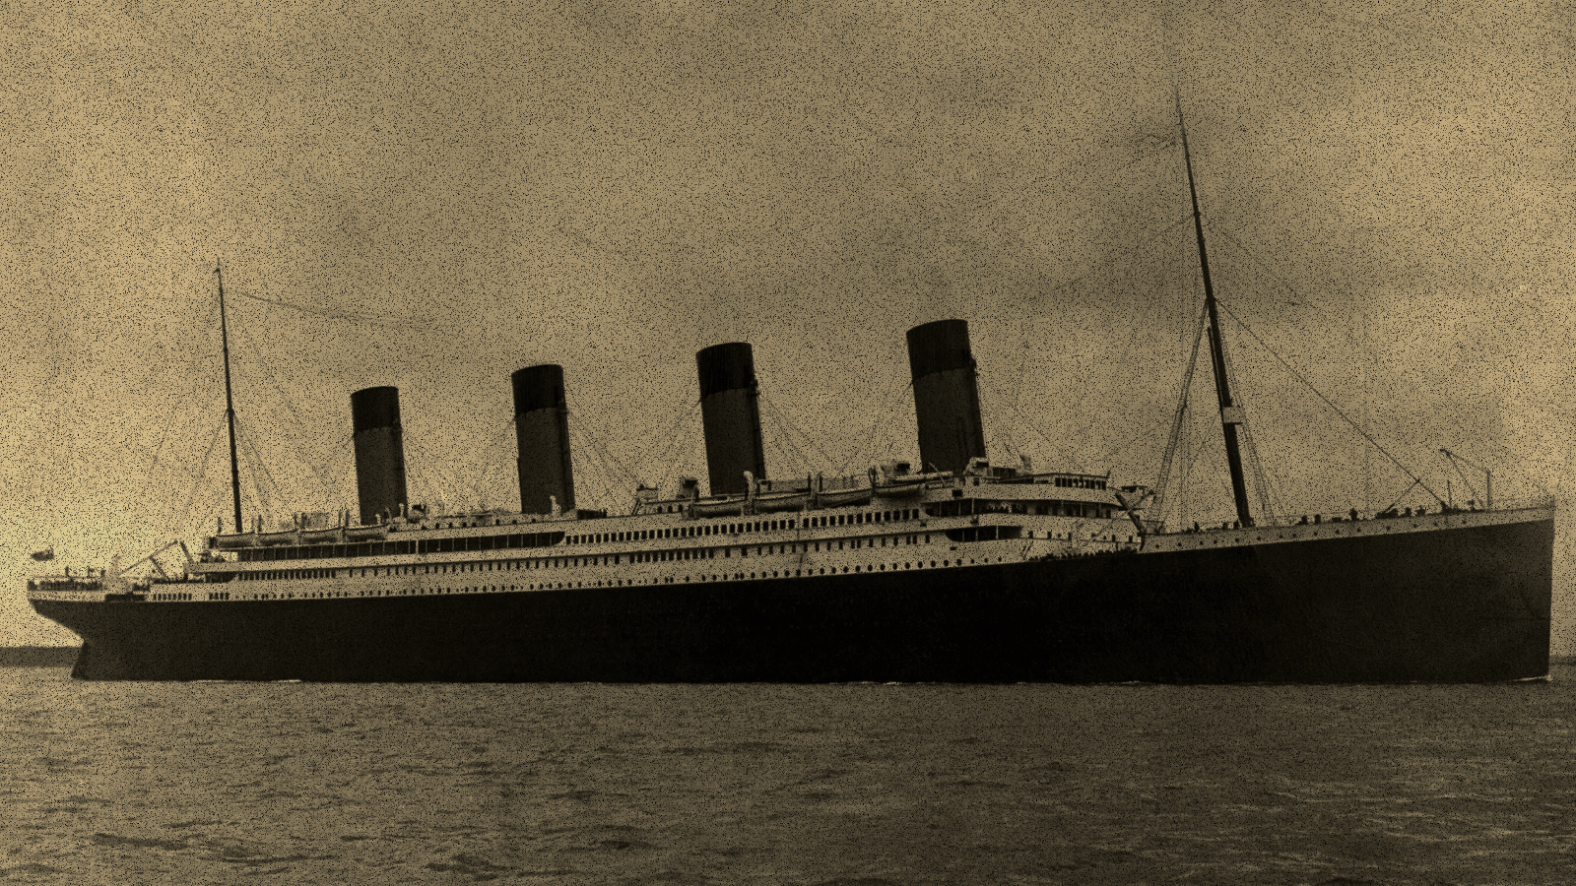
Titanic Disaster Data Analysis on Survivability Rate
An analysis made by
Thomas Amarta Gunawisesa - 2401960763
Divaldy Putra Eka - 2440018394
Daniel Alexander - 2440006715
Jeremiah Dylan Julianto - 2401960284
Christopher Nathanael - 2440012421
June 2022

Slide 2
Agenda
1
Project overview and background
2
Data Preparation
3
Basic Analysis
4
Conclusion
June 2022
2

Slide 3

1
Project Overview and Background

Slide 4
We have understand about the dataset and set our scope of work with the availability for our project execution..
Project Description
The Titanic tragedy is one of the big tragedies in maritime history. This tragedy occurred in April 1912, resulting in deaths out of 1500, including the crew members and passengers on the ship. This tragedy happened because RMS Titanic crashed into an iceberg that damaged the ship, causing water to enter it until it finally sank. Although there were many casualties, some groups still were more likely to survive than others.
Project Aim
Expected Output
1
Utilize basic analysis library on python to analyze each variable correlation to measure survivability rate on each variable.
Data visualization for each variables
Data report
Our Conclusion
2
Utilize machine learning algorithm to predict which variable that create correlation with survivability rate
Learning Curve
Machine Learning test output
Related variable that give ascendency on survivalbility factor.
June 2022
Our vision is to build a connection throughout the community for those who has the same interest in programming field and expands everyone knowledge in programming.

Slide 5
2
Data Preparation

Slide 6
Import Library and Dataset
Library | Function
Numpy | Mathematical Function
Pandas | File Reading
Sklearn.Preprocessing.LabelEncoder | Data Normalization
Sklearn.model_selection.Train_test_split | Split arrays or matrices into random train and test subsets.
Matplotlib.Gridspec | Maintain aesthetics of the data visualisation
matplotlib.pyplot | Provides an implicit, MATLAB-like, way of plotting.
seaborn | Data visualization
Sklearn.ensemble.RandomForestClassifier | Machine Learning
Sklearn.model_selection Learning_curve ShuffleSplit | Estimate ML model performance Split data into train and test dataset
June 2022
Our vision is to build a connection throughout the community for those who has the same interest in programming field and expands everyone knowledge in programming.

Slide 7
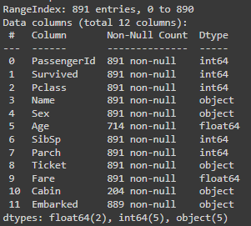
Before we analyze the data we aware that the dataset that we found on kaggle.com need to be check before we use it..(1/3)
Raw Data Exploration
June 2022
Our vision is to build a connection throughout the community for those who has the same interest in programming field and expands everyone knowledge in programming.
Product Analysis
Recommendation

Slide 8
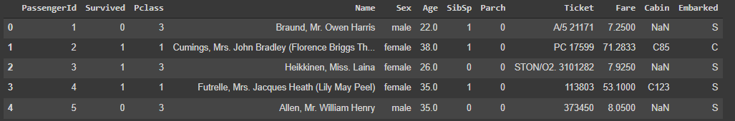
Before we analyze the data we aware that the dataset that we found on kaggle.com need to be check before we use it..(2/3)
June 2022
Our vision is to build a connection throughout the community for those who has the same interest in programming field and expands everyone knowledge in programming.
Product Analysis
Recommendation

Slide 9
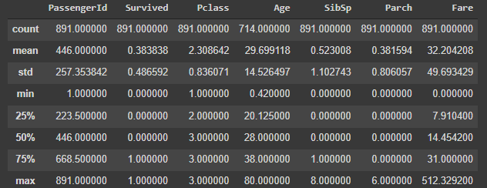
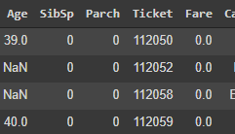
Before we analyze the data we aware that the dataset that we found on kaggle.com need to be check before we use it..(3/3)
We found out that the minimum value for fare is 0. Which considered to be an anomaly and need to be look in further.
Key Takeaways
After we look deeper into the data there are some facts report from www.encylopedia-titanica.org. That there are some passenger that have the same Ticket ID and have free ticket from some ship crew.
June 2022
Our vision is to build a connection throughout the community for those who has the same interest in programming field and expands everyone knowledge in programming.
Product Analysis
Recommendation

Slide 10
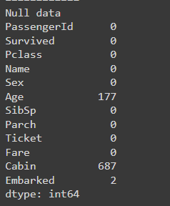
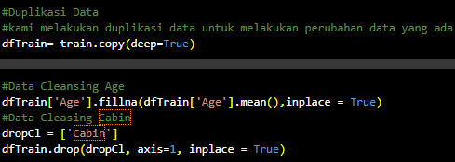
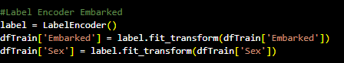
After we understand about our data set we move on into the next step
Data Cleansing
Solution
1. For Age data we will use mean
2. For Cabin data we will delete the column because it has many NULL values ​​which can affect the final result
3. For embark data we will use a label encoding algorithm to fill NULL values
June 2022
Our vision is to build a connection throughout the community for those who has the same interest in programming field and expands everyone knowledge in programming.
Product Analysis
Recommendation

Slide 11
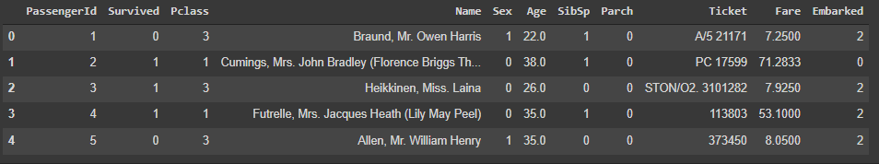
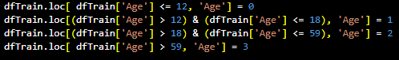
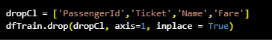
Data Cleansing
Solution
Splitting age into 4 category.
#<12 =0
#13-18 = 1
#19-59=2
#>60
Drop Ticket, PassangerId, Name.
Doesn’t have direct correlation with survivability rate
Drop Fare
we found an anomaly where when both people have the same class ticket but they pay different prices.
June 2022

Slide 12
3
Basic Analysis

Slide 13
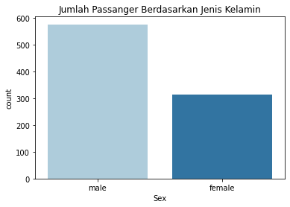
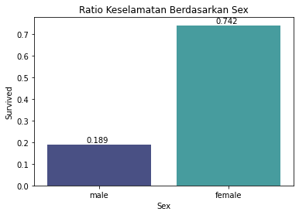
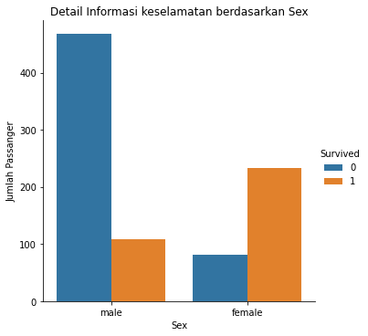
Sex
From the data above we can conclude that Female passengers have a higher chance of surviving than Male passengers.
1. Female 74%
2. Male 18%
June 2022

Slide 14
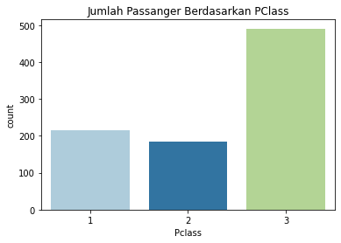
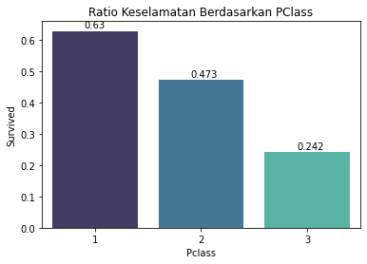
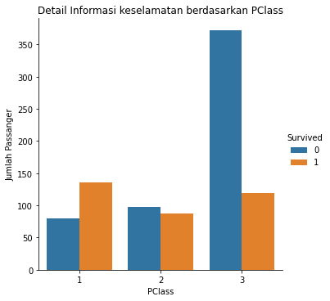
Pclass
From the data above, we can conclude that passengers in Class 1 have a higher chance of surviving. The details will be sorted as follows:
Class 1> Class 2> Class 3
63% > 47.3%>24.2%
June 2022

Slide 15
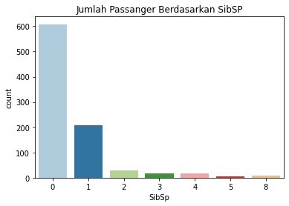
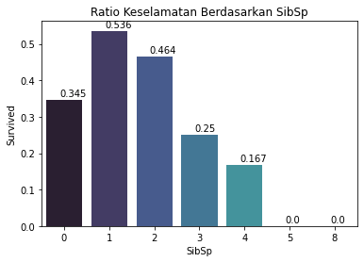
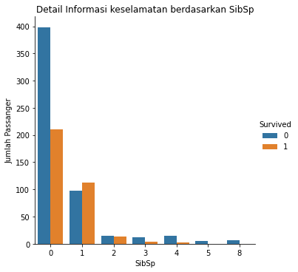
Sibling/Spouse
From the data above we can conclude that passengers who are with 1-2 Sibling/Spouse have a higher chance of surviving with the following details:
1>2>0>3>4>5,8
June 2022

Slide 16
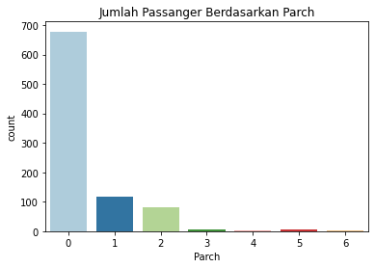
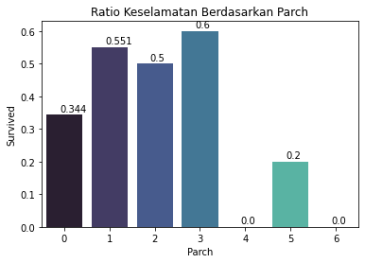
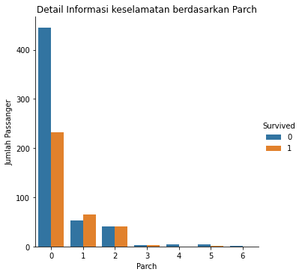
Parent/Child
From the data above we can conclude that passengers who are with 1-3 Parent/Child have a higher chance of surviving
with the following details:
3>1>2>0>5>4>6
June 2022

Slide 17
Deep Analysis on SibSp and Parch
We decided to create a new column, namely Family Size and IsAlone to find out more clearly the existing relationship.
June 2022

Slide 18
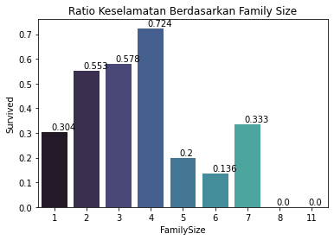
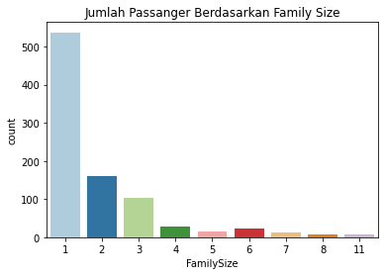
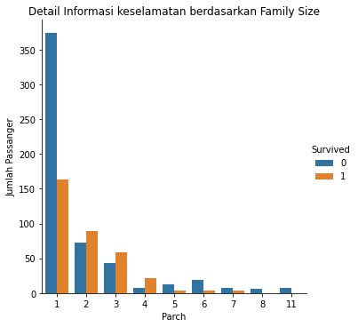
Family Size
From the data above we can conclude that every passenger who has a *Family Size* of 2,3,4, and 7 has a higher potential for survival.
From this data, we see that FamilySize = 1 still has a probability of survival that is not much different from passengers with SibSp or Parch which are 0. Surprisingly passenger with family size of 4 has the highest survivability rate.
June 2022

Slide 19
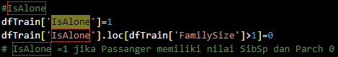
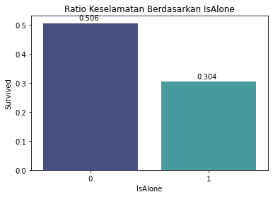
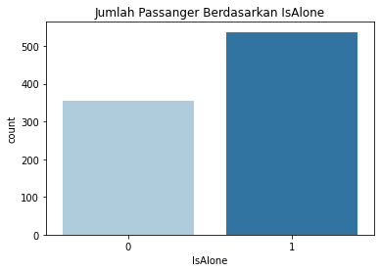
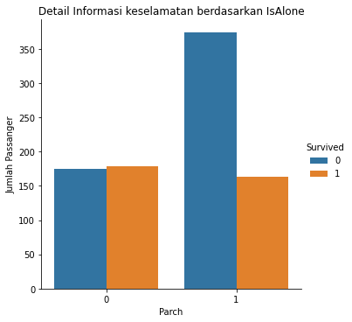
Is Alone
From the results of the data above, we can see that it is proven that every Passenger who brings their relative (Family Size > 1) are most likely to survive. This proves our previous statement is true.
June 2022

Slide 20
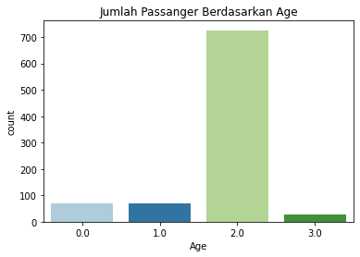
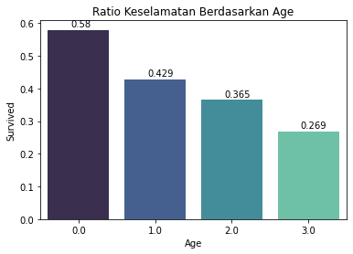
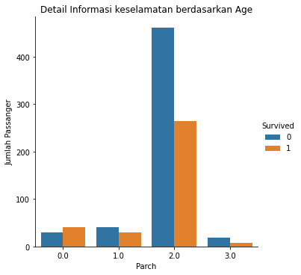
Age
From the data above, we can see that Passenger who is in age Group 0 (0-12 yo) has a higher chance of survival than other age groups.
June 2022

Slide 21
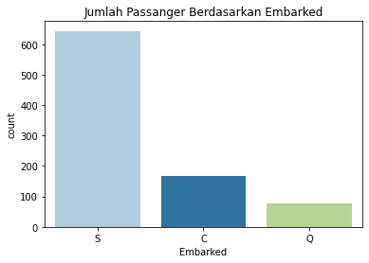
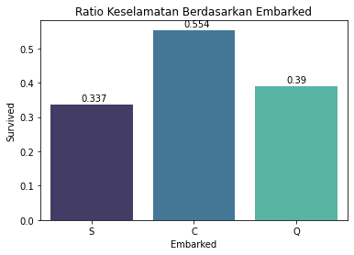
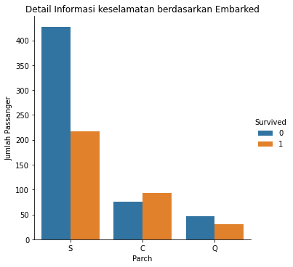
Embarked
From the data above we can conclude that Passenger who left Cherbough, France has a higher chance of surviving.
June 2022

Slide 22
We found out that there is some unique variable that we could do further analysis so we manage to do some…
Deep Analysis on Embarked
In this case, after we know that passengers who are not alone and bring their families have a high probability of surviving, we want to do an in-depth analysis regarding:
1. How many passengers with family size more than 1 and alone
2. How many passengers are aged < 13
3. How many female passengers
4. How many passengers according to PClass
June 2022

Slide 23
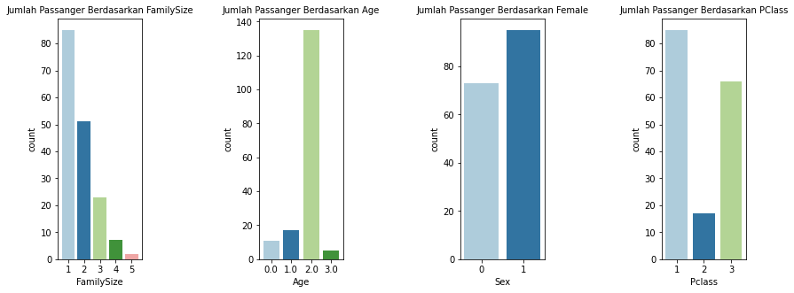
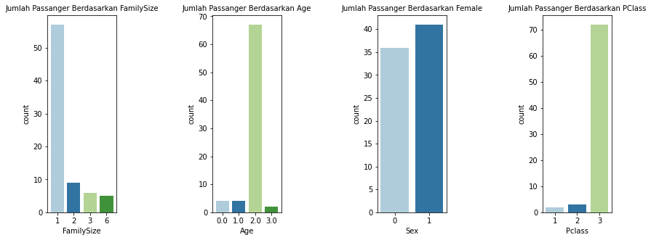
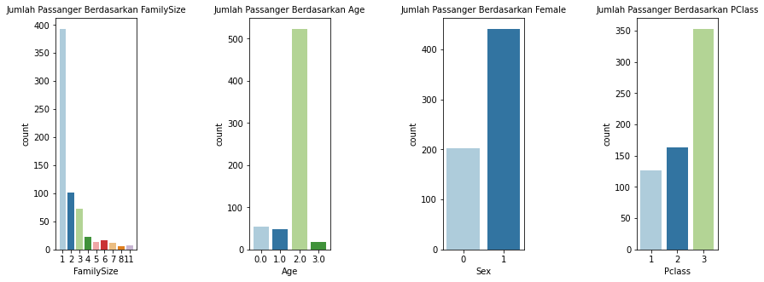
C
Q
S
June 2022

Slide 24
Deep Analysis on Sex Result
From the results of the analysis above, we can conclude several things:
1. Sex and Class factors are the most dominant factors in the Embark C case which gives the highest survival rate compared to other Embarked categories.
2. Family size Age and Pclass factors are the dominant factors that result in the lowest Embarked Q survival rate
3. Family Size, age, and Class factors are the dominant factors that result in the lowest Embarked S survival rate
From this we also know that the survivability factor of embarked C is based on.
1. Not based on the Family Size factor
2. Not based on Age
3. Having the number of Females is more dominant than Male
4. Has a more dominant number of 1st class passengers than other Pclass
June 2022

Slide 25
Deep Analysis on Sex
In this case, we want to find out more about the sex relationship with an in-depth analysis related to it
1. How many passengers Female family size 2-4
2. How many Female passengers are aged < 12
3. How many Female passengers are according to the number of classes
June 2022

Slide 26
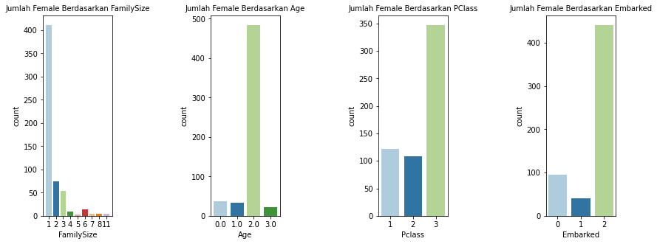
Female
Male
June 2022

Slide 27
Deep Analysis on Sex Result
From the data above, we cannot find why female passengers have a higher survival rate than male passengers. Finally, we decided to do in-depth research on the Safety SOP in the event of a disaster.
It is known that the Birkenhead drill was a well-known safety procedure in 1852. In 1920 when the Titanic incident occurred this procedure was carried out by the crew, resulting in women and children having a very high survivalbility rate.
source: https://www.mentalfloss.com/posts/women-and-children-first-origins-titanic
https://en.wikipedia.org/wiki/Women_and_children_first
Although it has a strong correlation that we can see on the heatmap. However, this sex variable stands alone without being tied to other variables.
June 2022

Slide 28
4
Prediction Analysis

Slide 29
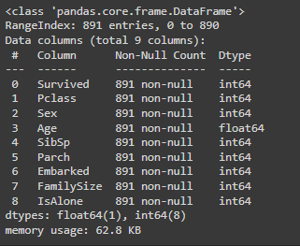
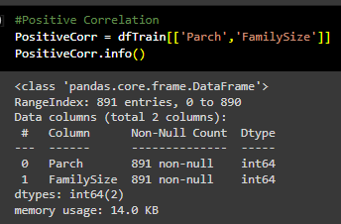
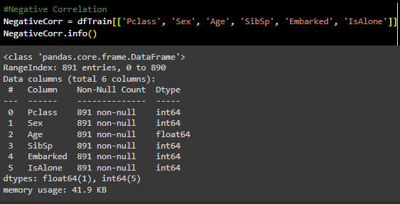
We found out that our data already normalize in data cleansing, we did our next step to start our machine learning(1/2)
Feature Engineering
Features
All
Positive
Negative
June 2022

Slide 30
We found out that our data already normalize in data cleansing, we did our next step to start our machine learning(2/2)
Machine Learning Result
Features
All
Positive
Negative
June 2022

Slide 31
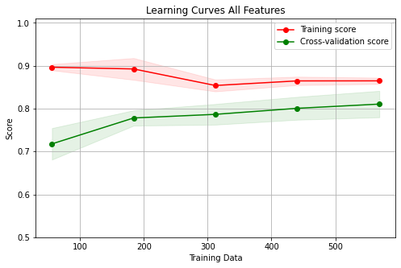
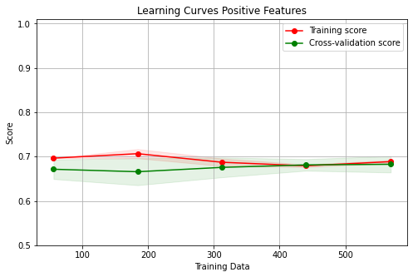
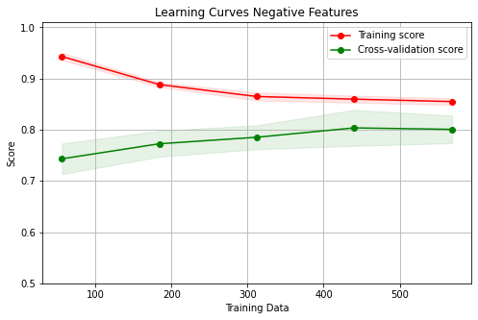
Our evaluation on Our machine learning result (1/2)
Learning Curve
Features
All
Positive
Negative
June 2022

Slide 32
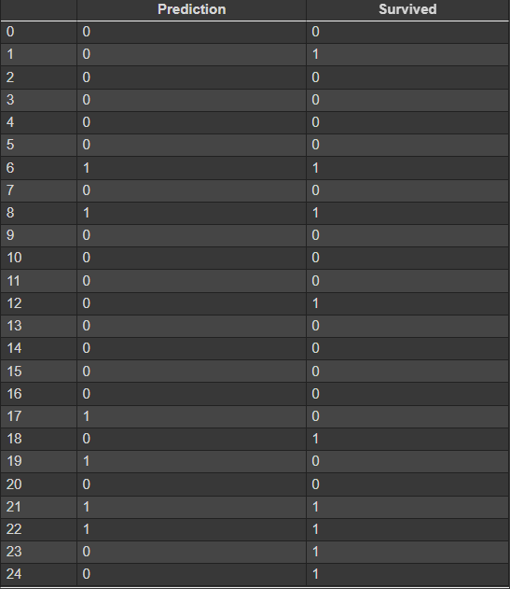
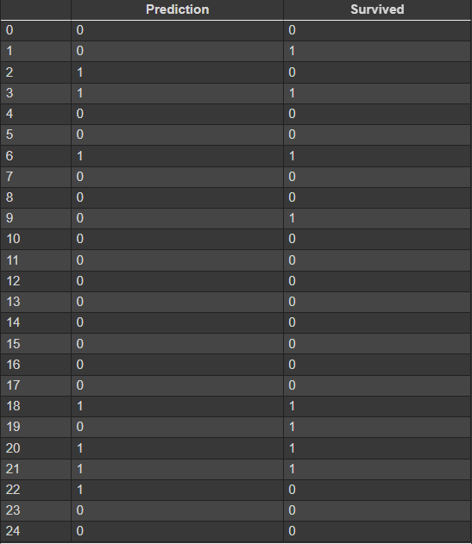
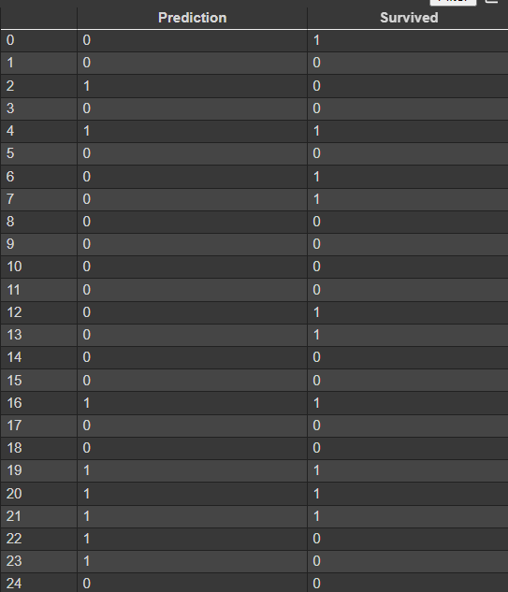
Our evaluation on Our machine learning result (1/2)
Prediction Ouput
Features
All
Positive
Negative
June 2022

Slide 33
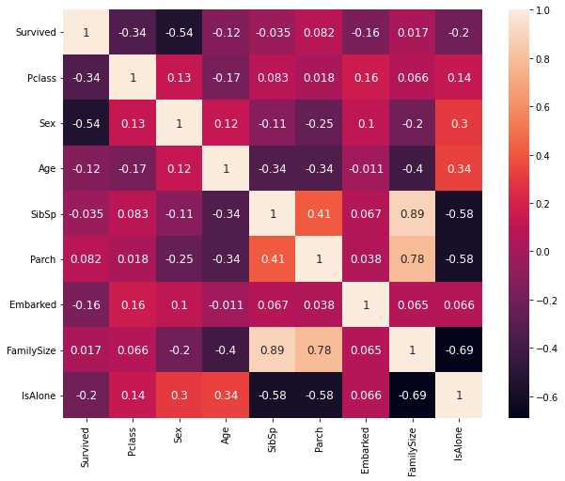
Conclusion
Strong Related Values
From the results of the machine learning analysis above, we can see that the biggest factor that affects the survivalbility rate is Sex . Sex has an important role in this titanic case and hopefully in the future we can learn more about safety procedures that allow us to save everyone regardless of gender.
ML Performance
Turns out Random Forest Classifier Performance is not good enough with positive correlation. We can conclude that positive correlation variable does not give huge impact for the machine learning training process.
Random Forest also give good performance is not overfitting or underfitting as well with scores 0.86
June 2022

Slide 34
Thank you
CopyRight @ Kelompok Daniel Alexander
June 2022

Slide 35
Appendix
June 2022

Slide 36

Appendix (slide 9 )
June 2022

Slide 37
Journal
[1] A. G. Kosheleva Vladik Kreinovich, and Olga, “Why 70/30 or 80/20 Relation Between Training and Testing Sets: A Pedagogical Explanation”.
[2] M. Hardy, “Pareto’s Law,” The Mathematical Intelligencer, vol. 32, no. 3, pp. 38–43, Jul. 2010, doi: 10.1007/s00283-010-9159-2.
[3] M. Debczak, “The Origins of ‘Women and Children’ First,” Mental Floss, Apr. 19, 2022. [Online]. Available: https://www.mentalfloss.com/posts/women-and-children-first-origins-titanic
[4]B. S. Frey, D. A. Savage, and B. Torgler, “Noblesse oblige? Determinants of survival in a life-and-death situation,” Journal of Economic Behavior & Organization, vol. 74, no. 1–2, pp. 1–11, May 2010, doi: 10.1016/j.jebo.2010.02.005.
[5]J. Nithyashri and G. Kulanthaivel, “Classification of human age based on Neural Network using FG-NET Aging database and Wavelets,” 2012 Fourth International Conference on Advanced Computing (ICoAC), Dec. 2012, doi: 10.1109/icoac.2012.6416855.
June 2022

Slide 38
Reference

